Slide 1
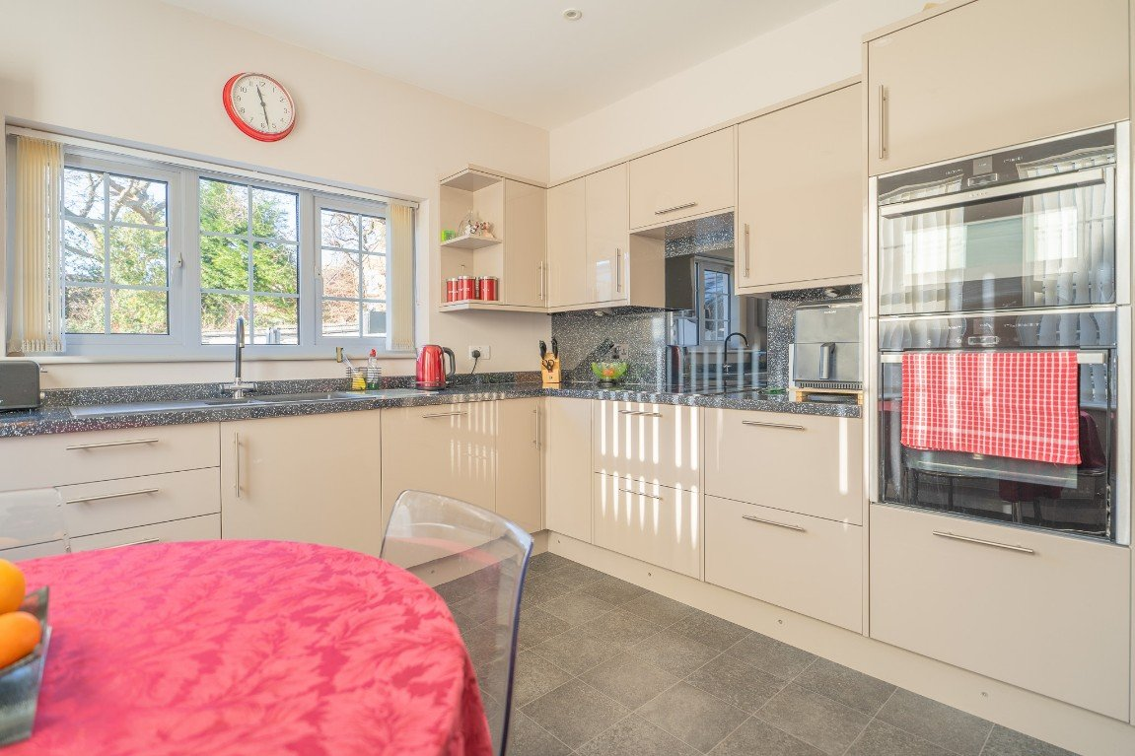
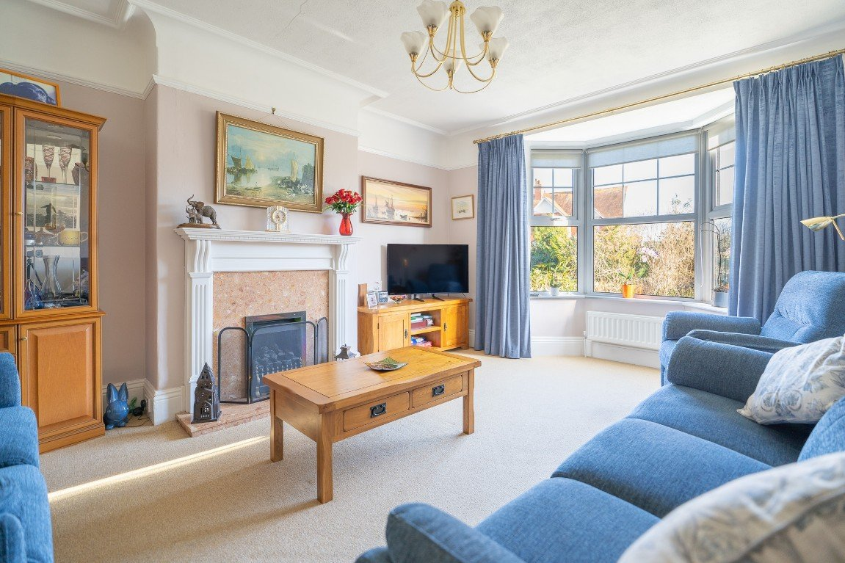
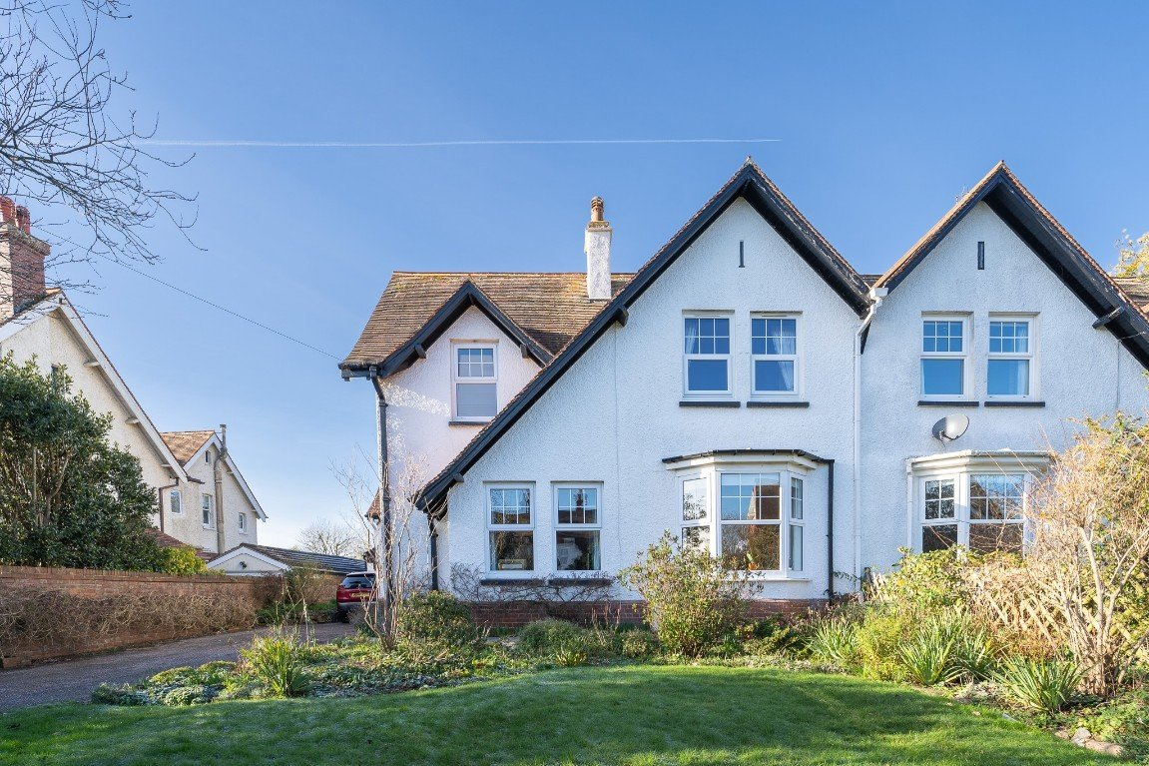
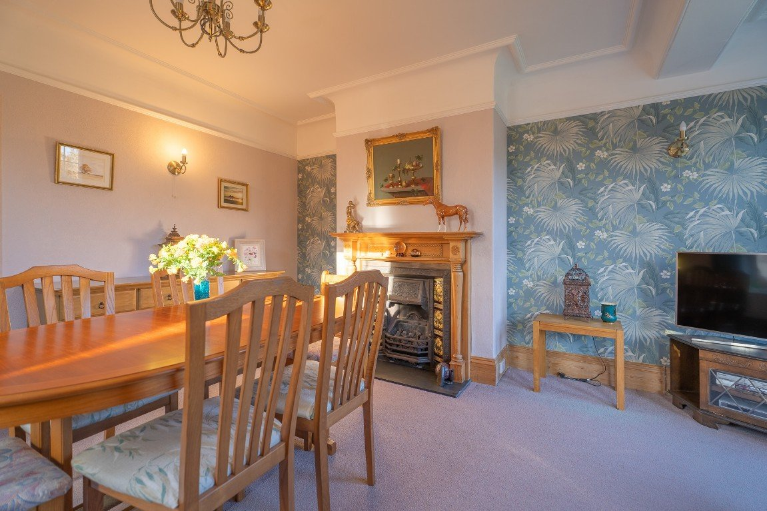
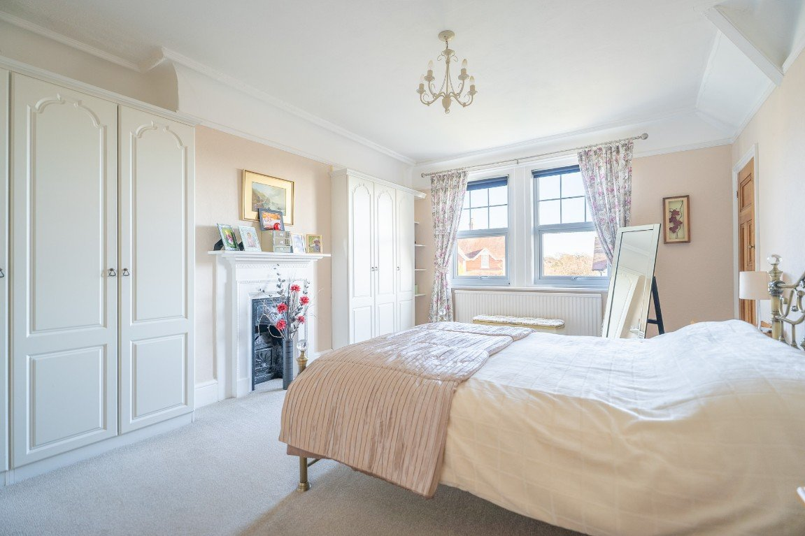
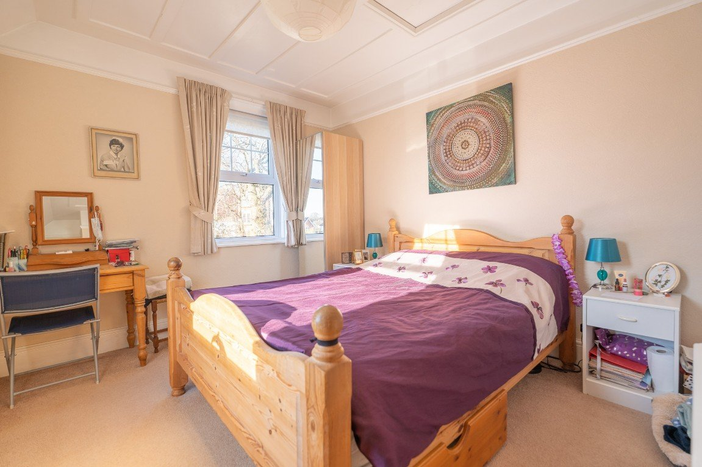
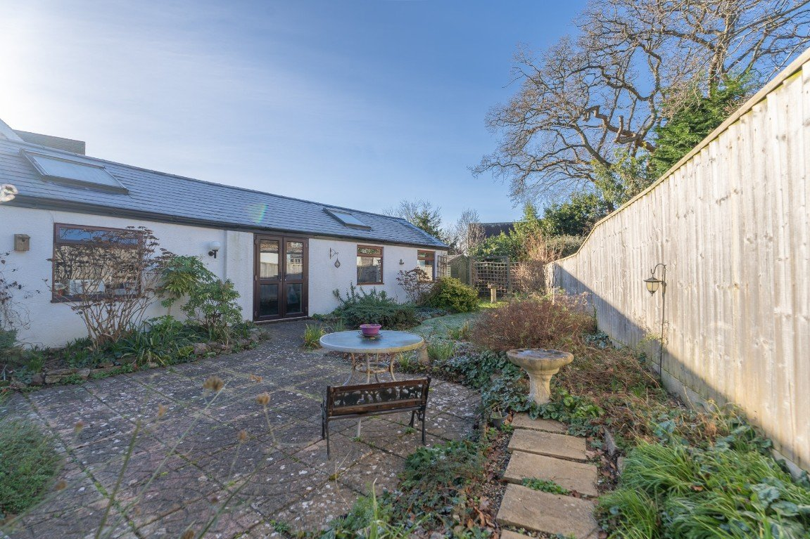
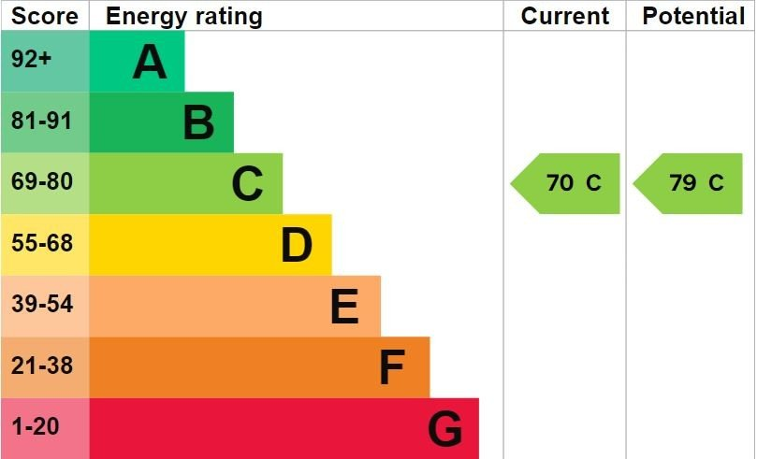
www.pennys.net
10 The Broadway, Exmouth, EX8 2NW
GUIDE PRICE £670,000
TENURE Freehold
A Truly Stunning Four Bedroom Semi Detached Residence Located In A Highly Sought After Area With Attractive Gardens, Ample Parking, Garage And Large Studio
Extremely Spacious And Beautifully Presented Residence • Impressive Reception Hall •
Good Size Lounge And Separate Dining Room •
Stylishly Modern Kitchen/Breakfast Room • Utility Room •
Study • Superb Ground Floor Shower Room/WC • Four First Floor Bedrooms •
First Floor Bathroom Suite • Beautiful Gardens, Garage And Substantial Studio •
Pennys Estate Agents Limited for themselves and for the vendor of this property whose agents they are give notice that:- (1) These particulars do not constitute any part of an offer or a contract. (2) All statements contained in these particulars are made without responsibility on the part of Pennys Estate Agents Limited. (3) None of the statements contained in these particulars are to be relied upon as a statement or representation of fact. (4) Any intending purchaser must satisfy himself/herself by inspection or otherwise as to the correctness of each of the statements contained in these particulars. (5) The vendor does not make or give and neither do Pennys Estate Agents Limited nor any person in their employment has any authority to make or give any representation or warranty whatever in relation to this property.
PENNYS ESTATE AGENTS
2 Rolle House, Rolle Street, Exmouth, Devon, EX8 2SN
Tel: 01395 264111 EMail: help@pennys.net

Slide 2
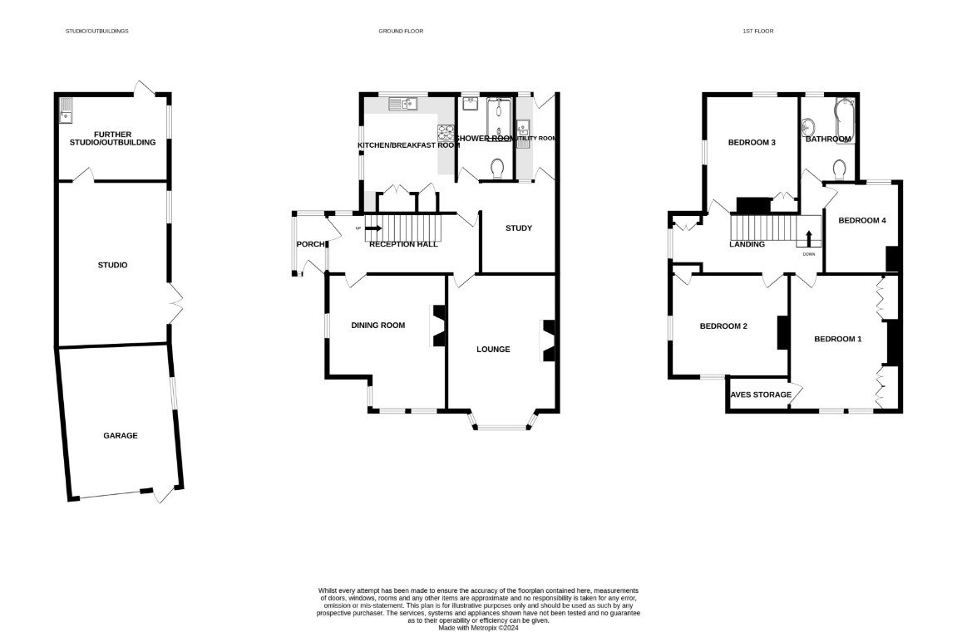
10 The Broadway, Exmouth, EX8 2NW
Pennys are delighted to offer for sale this stunning semi detached house built, we understand in 1904 the property offers bright, spacious accommodation which has been enhanced in recent years by the present owner and provides ideal accommodation for those looking for a spacious home in a high quality location. In addition to the four Bedroom accommodation the property enjoys a garage plus large Studio area which could be adapted for a variety of uses; beautiful, well tended gardens to the front and rear, ample parking and substantial garage. Viewing strongly recommended. THE ACCOMMODATION COMPRISES: uPVC front door with glazed patterned panel window inset leads to: ENTRANCE PORCH: uPVC double glazed windows with pattern glass; tiled flooring; light; inner uPVC double glazed door with patterned glass giving access to: RECEPTION HALL: A fine entrance to the property with staircase with impressive balustrade rising to the first floor; useful understairs cupboard; radiator housed in radiator cover; cupboard housing meters with display surface over; picture rail; uPVC double glazed window; sash window overlooking the ENTRANCE PORCH. LOUNGE: 5.38m x 4.01m (17'8" x 13'2") maximum overall measurement. A charming room with uPVC double glazed window to the front elevation; attractive wooden fireplace with marble hearth inset housing living flame effect coal gas fire; two radiators; television point; picture rails. DINING ROOM: 4.88m x 4.24m (16'0" x 13'11") maximum measurement into wall recesses and uPVC double glazed window to front elevation. A most spacious room with wooden fire surround with slate hearth inset and housing living flame effect coal gas fire with pattern tiled inset; picture rails; radiator; feature port hole style window. KITCHEN/BREAKFAST ROOM: 4.09m x 3.3m (13'5" x 10'10") Stylish modern room with a range of pattern work top surfaces with matching splash backs; inset one and a quarter bowl sink unit with mixer tap; range of cupboards, drawers and integrated dishwasher beneath work tops; inset four ring induction hob with glass splash back and extractor fan over; built-in oven and grill; matching eye level cupboards; integrated fridge housed in chimney recess; cupboard housing Worcester gas boiler with shelved cupboard beneath; recess ceiling LED spotlights; uPVC double glazed windows to front and side elevations. STUDY: 3.3m x 2.74m (10'10" x 9'0") A versatile room with radiator; glazed door to: UTILITY ROOM: 3.15m x 1.42m (10'4" x 4'8") Fitted with pattern work top surfaces with plumbing for an automatic washing machine and tumble dryer space beneath; space for further white goods beneath; tiled splash backs; eye-level wall cupboards; double glazed velux window; uPVC double glazed window and uPVC double glazed door giving access to the rear garden. GROUND FLOOR SHOWER ROOM/WC: 3.1m x 1.93m (10'2" x 6'4") Modern suite with ease of access shower cubicle with splash back walls and shower screens; Mira shower unit; vanity wash hand basin; WC with push button flush with concealed cistern; mirror fronted medicine cabinet; chrome heated towel rail; radiator; tiled floor; recess ceiling LED spotlighting; uPVC double glazed window with pattern glass. From the Reception Hall an impressive staircase rises to: BEDROOM ONE: 4.88m x 3.96m (16'0" x 13'0") maximum measurement into wall recess. A fine main bedroom with two uPVC double glazed windows to front aspect; radiator; picture rail; two built-in wardrobes; feature cast iron fireplace housed within feature fire surround; access to good size walk-in wardrobe. BEDROOM TWO: 4.24m x 3.63m (13'11" x 11'11") An excellent guest room with uPVC double glazed windows to front and side elevations; radiator; picture rail; fitted wardrobe in wall recess with clothes hanging rail and storage cupboards over; telephone point. BEDROOM THREE: 4.24m x 3.33m (13'11" x 10'11") A bright dual aspect room with uPVC double glazed windows to rear and side elevations; radiator; picture rail; fitted wardrobe in wall recess with clothes hanging rail and storage cupboards over; telephone point. BEDROOM FOUR: 3.28m x 2.74m (10'9" x 9'0") uPVC double glazed window to rear elevation; radiator; feature fireplace.
BATHROOM/WC: Comprising of a bath with Mira shower unit and curved shower splash screen; pedestal wash hand basin with chrome mixer tap over; WC with push button flush; attractive extensively tiled walls; tiled flooring; radiator; wall mounted medicine cabinet; two uPVC double glazed windows with pattern glass. OUTSIDE: The property is approached via a long driveway providing ample off-road parking with an outside cold water tap, courtesy lighting and leading to a garage. Directly to the front of the property is an attractive garden, laid to lawn and edged with large, well stocked, colourful flower and shrub beds. From the driveway a wooden side gate gives access to the rear garden which is a lovely feature of the property being well planned and attractively presented. Comprising of a good size patio sun terrace ideal for alfresco dining and lawned garden edged with well stocked flower and shrub beds, timer shed and greenhouse. Accessed via glazed double doors from the garden is a: STUDIO: 5.72m x 3.96m (18'9" x 13'0") A versatile room which could be adapted for a variety of uses, currently comprises of a sealed unit double glazed window to side elevation; Dimplex night storage; velux window; feature ceiling beams; power and light connected; door to: FURTHER OFFICE/STUDIO: 3.96m x 3.1m (13'0" x 10'2") Fitted with a stainless steel single drainer sink unit with cupboards over and electric wall heater; tiled surround; feature ceiling beams; Dimplex night storage heater; sealed unit double glazed window to side elevation; uPVC double glazed wood effect door with patterned glass giving access back into the rear garden. GARAGE: 4.88m x 4.47m (16'0" x 14'8") With electric roller door and additional uPVC wood effect door; power and light connected; velux window and further window to side elevation; ceiling beams. FLOOR PLAN:

